Slide 1
Connectionist Computing
COMP 30230/41390
Gianluca Pollastri
office: CASL, ground floor Science East.
email: gianluca.pollastri@ucd.ie
Connectionist Computing COMP 30230

Slide 2
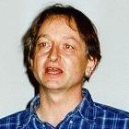


Credits
Geoffrey Hinton, University of Toronto.
  borrowed some of his slides for “Neural Networks” and “Computation in Neural Networks” courses.
Ronan Reilly, NUI Maynooth.
  slides from his CS4018.
Paolo Frasconi, University of Florence.
  slides from tutorial on Machine Learning for structured domains.
Connectionist Computing COMP 30230

Slide 3
Lecture notes on Moodle
https://csmoodle.ucd.ie/moodle/course/view.php?id=288
Strictly confidential...
Enrolment key: 30230cc
Connectionist Computing COMP 30230

Slide 4
Books
No book covers large fractions of this course.
Parts of chapters 4, 6, (7), 13 of Tom Mitchell’s “Machine Learning”
Parts of chapter V of Mackay’s “Information Theory, Inference, and Learning Algorithms”, available online at:
http://www.inference.phy.cam.ac.uk/mackay/itprnn/book.html
Chapter 20 of Russell and Norvig’s “Artificial Intelligence: A Modern Approach”, also available at:
http://aima.cs.berkeley.edu/newchap20.pdf
More materials later..
Connectionist Computing COMP 30230

Slide 5
Marking
3 landmark papers to read, and submit a 10-line summary on Moodle about: each worth 6.67%
a small connectionist tool to build and play with: 30%
Final exam: 50%
Connectionist Computing COMP 30230

Slide 6
Programming assignment
Implement a Multi-Layer Perceptron, test it.
The description on Moodle.
Submit through Moodle code and test results by April the 28th at 23:59, any time zone of your choice (Baker Island?).
30% of the overall mark
One third of a grade down every day late, that is: if you deserve an A and you’re 1 day late you get an A-, 2 days late a B+, etc.
Connectionist Computing COMP 30230

Slide 7
Assignment 3
Read the paper “Reducing the Dimensionality of Data with Neural Networks”, by Hinton and Salakhutdinov (2006).
Don’t panic!
The paper is on Moodle.
Submit through Moodle a 400 word MAX summary by April 18th at 23:59, any time zone of your choice (Baker Island?).
6.67% of the overall mark.
One third of a grade down every day late, that is: if you deserve an A and you’re 1 day late you get an A-, 2 days late a B+, etc.
Connectionist Computing COMP 30230

Slide 8
Natural assumptions
For the linear output case (regression), if we assume that P(t|y) is distributed like a Gaussian, the associated likelihood really looks just like a squared error.
This means that minimising the squared error really means doing ML.
[And if we add a bit of weight decay we can call it MAP]
Connectionist Computing COMP 30230

Slide 9
Natural assumptions 2
For the binary classification case, if we assume that P(t|y) is distributed binomially, the associated likelihood really looks just like a relative (mutual) entropy error.
If we implement the output using a sigmoid, taking the derivative of the error wrt the weights the only output term remaining is proportional to (t-y).
Connectionist Computing COMP 30230

Slide 10
Natural assumptions 3
For the multi-class classification case, if we assume that P(t|y) is distributed multinomially, the associated likelihood really looks just like a relative (cross) entropy error.
We saw before that if we implement the output using softmax, taking the derivative of the error wrt the weights the only output term remaining is proportional to (t-y).
Connectionist Computing COMP 30230

Slide 11
Deep networks?
output
code
input vector

Slide 12
Deep learning
Deep nets are expressive
But gradients vanish
A long history of ad hoc solutions
Over the last ten years, new solutions
Connectionist Computing COMP 30230

Slide 13
"New" deep learning 1.0
Layer by layer pre-training based on:
auto-association
  RBM (Deep Belief Networks)
  Hard targets for inner layers
More CPU and patience
Connectionist Computing COMP 30230

Slide 14
About pre-training
If by auto-association, can be done on unlabelled data:
  more data
  generic compression
Or, it can be done with a target (no auto-association):
  less data (needs to be labelled)
  target-driven compression
Connectionist Computing COMP 30230

Slide 15
Additional solutions
Different squashing units (e.g. rectified linear units)
Initialisation
Normalisation techniques for inputs to inner layers
…
Connectionist Computing COMP 30230

Slide 16
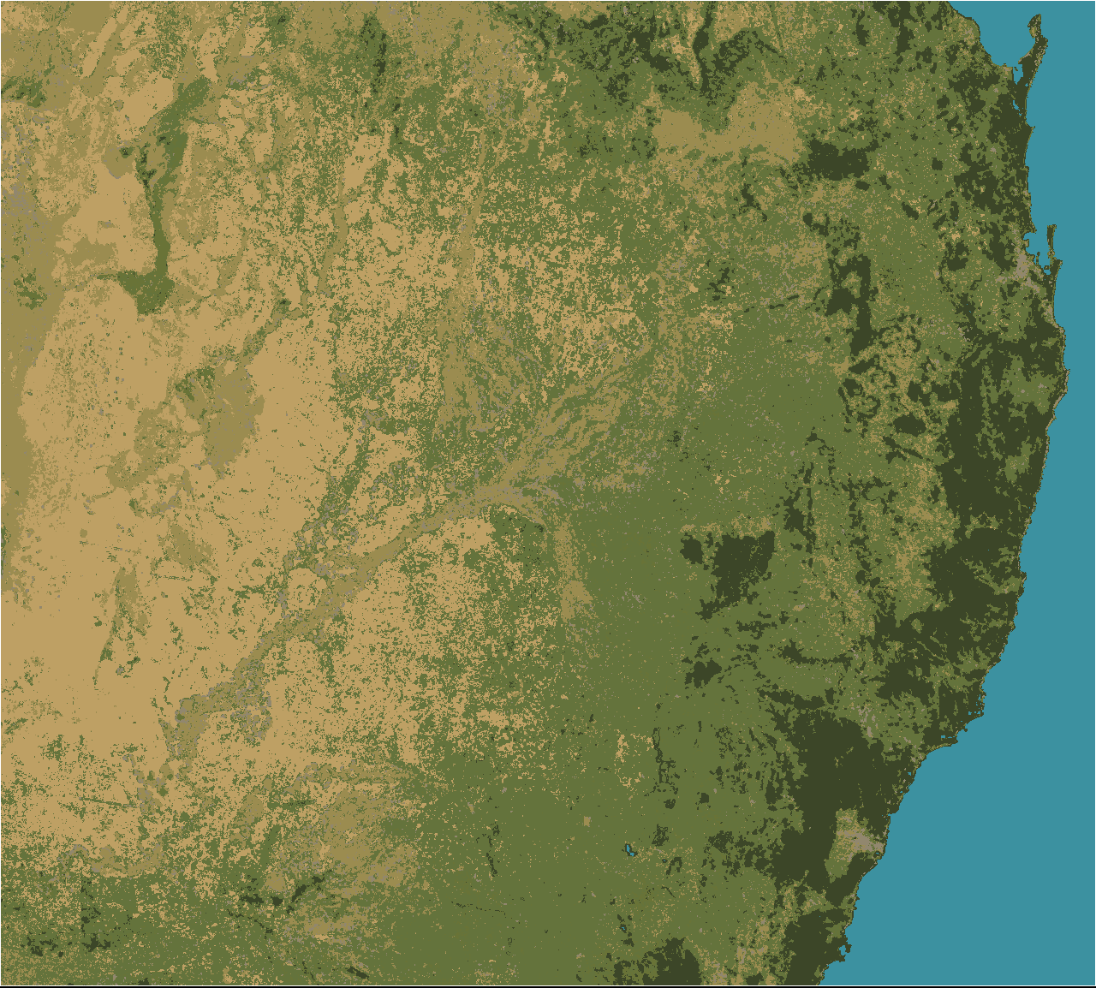


Slide 17
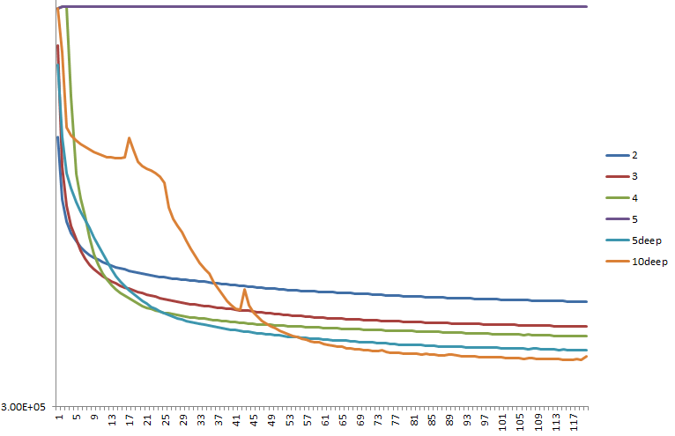
Land class classification

Slide 18
Protein bioinformatics
The input is a string (the primary sequence)
The target is whatever value added property of the protein we are interested in. E.g. protein function, secondary structure, solvent accessibility.

Slide 19
Protein bioinformatics
The input is a string (the primary sequence)
The target is whatever value added property of the protein we are interested in. E.g. protein function, secondary structure, solvent accessibility.
0.10$
100,000$ ?

Slide 20
Data
I dislike small sets. A 1000 point set isn't going to give you the same answer as a 1M point set. The winners will change.
I built a set of 23,000 proteins (6M examples)

Slide 21
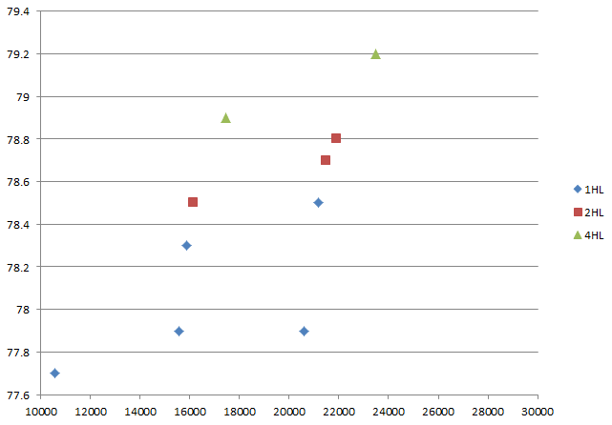
Secondary Structure prediction

Slide 22
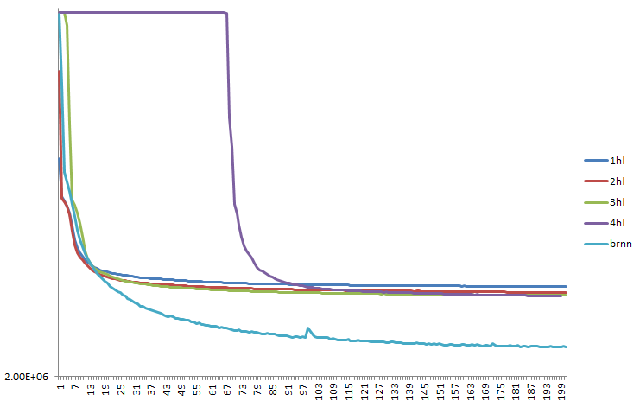
With BRNN..

Slide 23
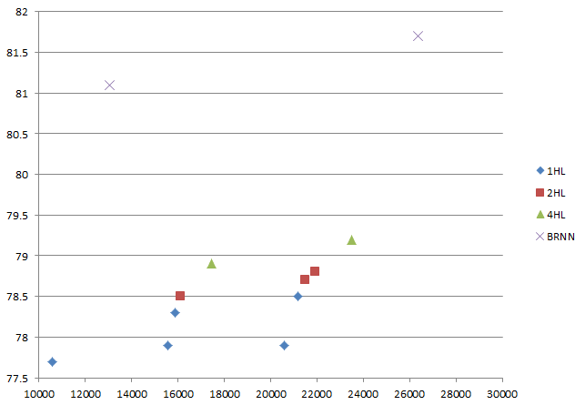
SS prediction with BRNN

Slide 24
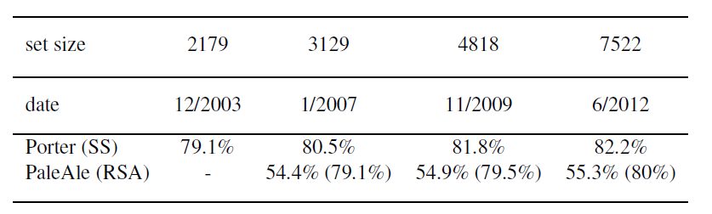
Data, data, data
The more the better..
Mirabello & Pollastri 2013, Bioinformatics

Slide 25
What did I learn about deep learning?
Layer-by-layer pre-training
Artificial targets for inner layers
They all worked the same for me.
Deeper nets work (slightly) better than shallow ones. The big gain is between 1 and 2 hidden layers, then it tapers
BUT: some cleverer deep wirings (BRNN) can yield major improvements.

Slide 26
It depends on the problem!
Deep learning has produced some pretty stunning results in some fields (e.g. computer vision).
In other fields, going from shallow to less shallow usually helps, but there is no need (or scope) for true deep learning.
Connectionist Computing COMP 30230

Slide 27
Algorithms plus data plus CPU (or GPU) plus ease of use
Many algorithms used in deep learning have been around for a while. At most they have been combined and shuffled cleverly.
The big changes are:
  immense amounts of data
  faster computers and, especially, the ability to run training algorithms on graphics cards 1+ orders of magnitude faster, $ for $
  A number of environments/libraries that have made formerly highly complicated implementations accessible
  A LOT of buzz..
Connectionist Computing COMP 30230

Slide 28
Next..
A number of deep architectures I have worked with.
Interestingly, most of them need only relatively lightweight (or no) deep learning techniques to be trained.
Connectionist Computing COMP 30230

Slide 29
Structure and neural nets
A great historical limitation of neural networks is that you have to decide beforehand how many inputs, outputs one has.
This means that only maps/functions where inputs and outputs are vectors of fixed, known length can be dealt with directly.
Connectionist Computing COMP 30230

Slide 30
Structure and neural nets (2)
Data tend to not come in fixed lengths.
We have to brutalise them into them.
Think of the features used for handwritten digit recognition. They may be good or not. But there is a good chance that they don't contain the full information available in the raw data.
Connectionist Computing COMP 30230

Slide 31
We should think ahead of the data
As more data become available and more complex problems are tackled, clever machine learning methods that stand on a few more parameters and a few more layers of complexity may also become useful…

Slide 32
Sequences as structure: N to N
Think of language (e.g. mapping words into sounds). It's an N-to-N map, where N is unknown a priori, and variable between different streams of text.
Think of biological sequences (DNA, proteins). Their lengths are wildly variable.
How do you design a network that can deal with ALL the different lengths?
Connectionist Computing COMP 30230

Slide 33
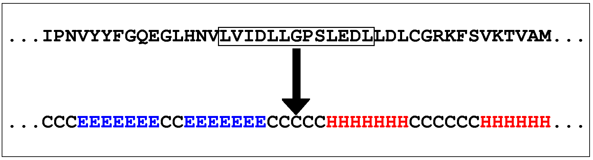
N-to-N: traditional solution
N is variable, and this is a problem.
Neural networks (and SVM, etc. etc.) like fixed sizes..
Split N-to-N into N W-to-1 maps (W fixed).

Slide 34
Problem
If we cut up the input string into windows of size W, we only see what is inside the window..
We consider only a few letters, we ignore most of them.
But we know that letters that matter may be anywhere, in some cases.
Infinite trial and error W? Overfitting?

Slide 35
Recurrent Neural Networks (RNN)
One of the earliest versions: Jeffrey Elman, 1990, Cognitive Science.
Problem: it isn’t easy to represent time with Feedforward Neural Nets: usually time is represented with space.
Attempt to design networks with memory.

Slide 36
RNNs
The idea is having discrete time steps, and considering the hidden layer at time t-1 as an input at time t.
This effectively removes cycles: we can model the network using an FFNN, and model memory explicitly.

Slide 37
Ot
Xt
d
It
d = delay element

Slide 38
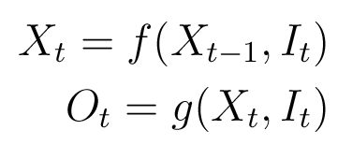
BPTT
BackPropagation Through Time.
If Ot is the output at time t, It the input at time t, and Xt the memory (hidden) at time t, we can model the dependencies as follows:

Slide 39
BPTT
We can model both f() and g() with (possibly multilayered) networks.
We can transform the recurrent network by unrolling it in time.
Backpropagation works on any Directed Acyclic Graph (DAG). An RNN becomes one once it’s unrolled.

Slide 40
Ot
Xt
d
It
d = delay element

Slide 41
Ot-2
Ot-1
Ot
Ot+1
Ot+2
Xt-2
Xt-1
Xt
Xt+1
Xt+2
It-2
It-1
It
It+1
It+2

Slide 42
gradient in BPTT
GRADIENT(I,O,T) {
# I=inputs, O=outputs, T=targets
T := size(O);
X0 := 0;
for t := 1..T
Xt := f( Xt-1 , It );
for t := 1..T {
Ot := g( Xt , It );
g.gradient( Ot - Tt );
δt = g.deltas( Ot - Tt );
}
for t := T..1
f.gradient( δt );
δt-1 += f.deltas( δt );
}

Slide 43
Ot-2
Ot-1
Ot
Ot+1
Ot+2
Xt-2
Xt-1
Xt
Xt+1
Xt+2
It-2
It-1
It
It+1
It+2

Slide 44
Ot-2
Ot-1
Ot
Ot+1
Ot+2
Xt-2
Xt-1
Xt
Xt+1
Xt+2
It-2
It-1
It
It+1
It+2

Slide 45
Ot-2
Ot-1
Ot
Ot+1
Ot+2
Xt-2
Xt-1
Xt
Xt+1
Xt+2
It-2
It-1
It
It+1
It+2

Slide 46
Ot-2
Ot-1
Ot
Ot+1
Ot+2
Xt-2
Xt-1
Xt
Xt+1
Xt+2
It-2
It-1
It
It+1
It+2

Slide 47
Ot-2
Ot-1
Ot
Ot+1
Ot+2
Xt-2
Xt-1
Xt
Xt+1
Xt+2
It-2
It-1
It
It+1
It+2

Slide 48
Ot-2
Ot-1
Ot
Ot+1
Ot+2
Xt-2
Xt-1
Xt
Xt+1
Xt+2
It-2
It-1
It
It+1
It+2

Slide 49
Ot-2
Ot-1
Ot
Ot+1
Ot+2
Xt-2
Xt-1
Xt
Xt+1
Xt+2
It-2
It-1
It
It+1
It+2

Slide 50
Ot-2
Ot-1
Ot
Ot+1
Ot+2
Xt-2
Xt-1
Xt
Xt+1
Xt+2
It-2
It-1
It
It+1
It+2

Slide 51
Ot-2
Ot-1
Ot
Ot+1
Ot+2
Xt-2
Xt-1
Xt
Xt+1
Xt+2
It-2
It-1
It
It+1
It+2

Slide 52
Ot-2
Ot-1
Ot
Ot+1
Ot+2
Xt-2
Xt-1
Xt
Xt+1
Xt+2
It-2
It-1
It
It+1
It+2

Slide 53
Ot-2
Ot-1
Ot
Ot+1
Ot+2
Xt-2
Xt-1
Xt
Xt+1
Xt+2
It-2
It-1
It
It+1
It+2

Slide 54
Ot-2
Ot-1
Ot
Ot+1
Ot+2
Xt-2
Xt-1
Xt
Xt+1
Xt+2
It-2
It-1
It
It+1
It+2

Slide 55
Ot-2
Ot-1
Ot
Ot+1
Ot+2
Xt-2
Xt-1
Xt
Xt+1
Xt+2
It-2
It-1
It
It+1
It+2

